Slide 1
Today After Lecture
Find Harshini or I to demo Lab 3

Slide 2
Lab 6: Sensing and Control

Slide 3
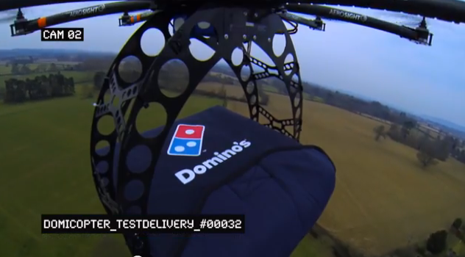
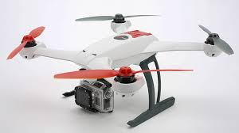
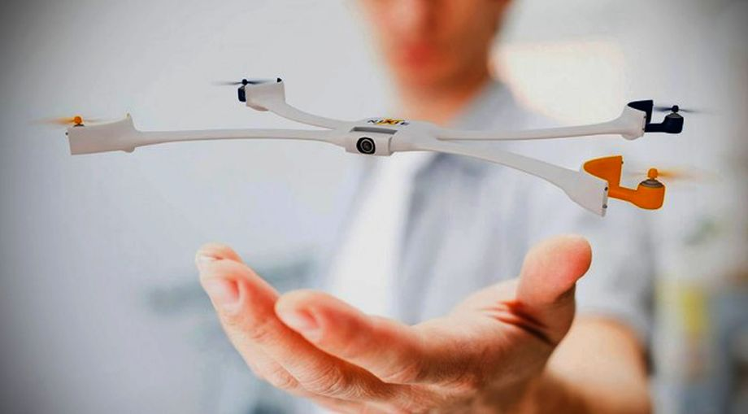
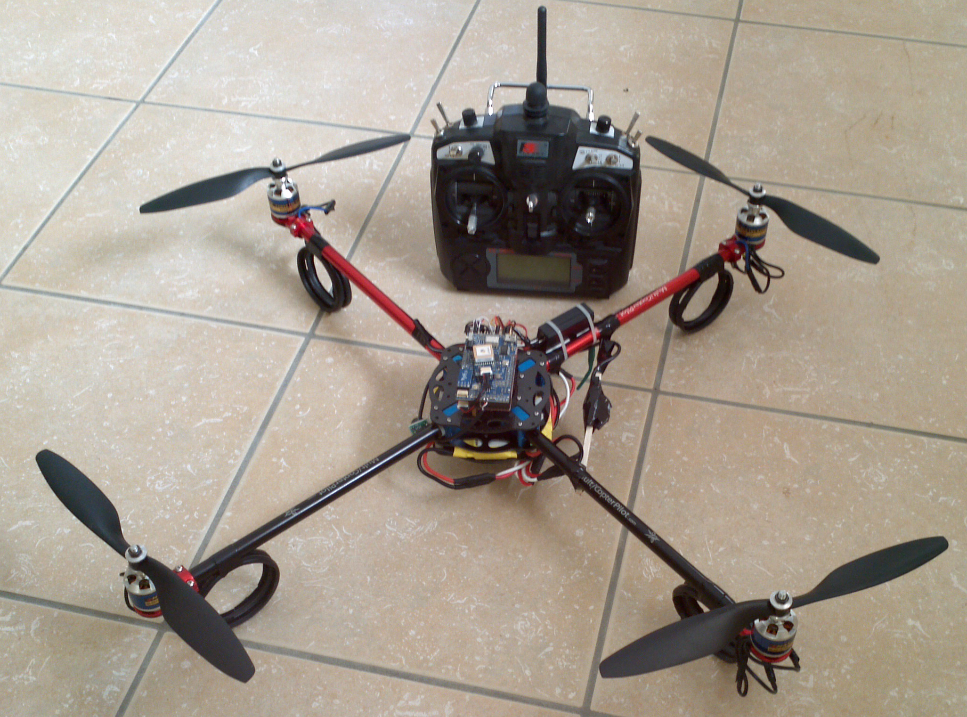
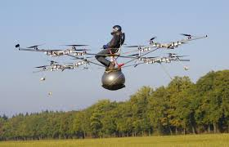
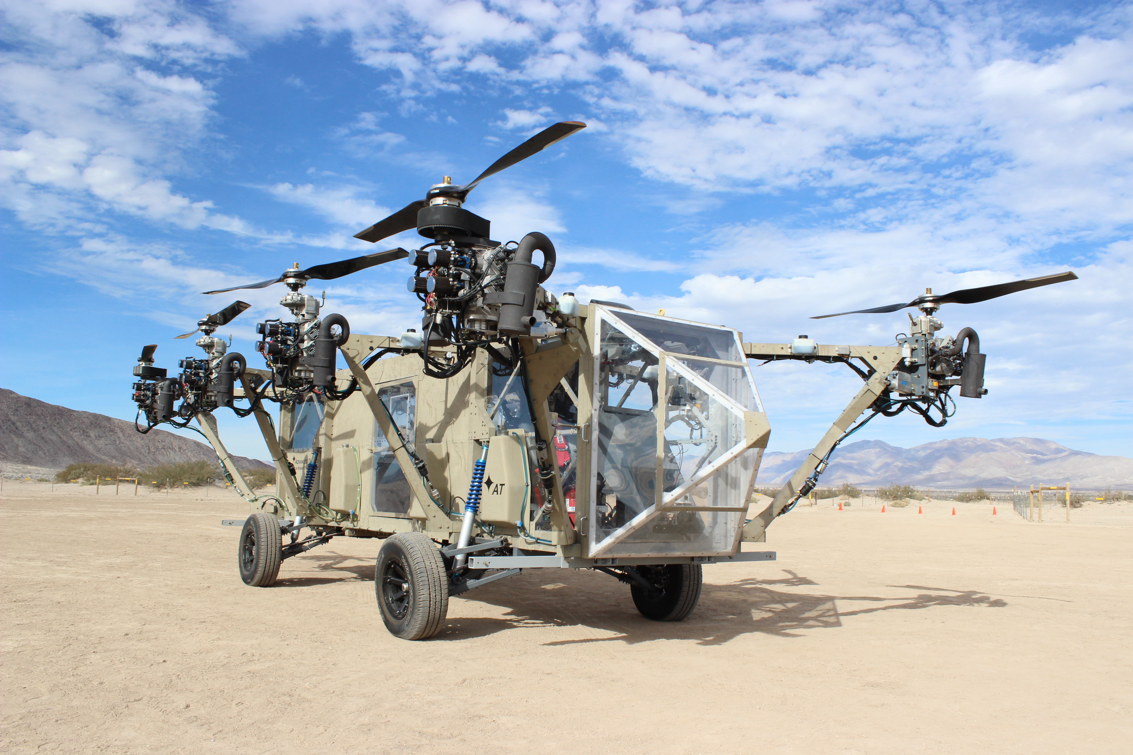
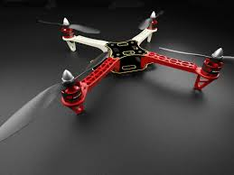
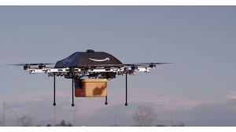
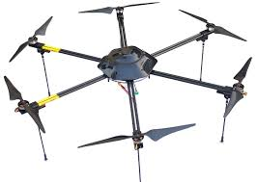

Slide 4
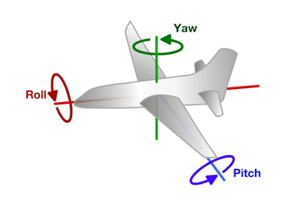
Principles of Operation (1)
An even number of motors provides lift and control in 6 dimensions
Spatial dimensions: x, y, z
Pitch: rotation around left-right (y) axis
Roll: rotation around the front-back (x) axis
Yaw: rotation around the top-bottom (z) axis
A flight computer operates a closed-loop controller to maintain stability and implement pilot commands.
Z
X
Y

Slide 5
Controlling Pitch
Pitch forward
More thrust to the rear
Less to the front
Pitch backward
Less thrust to the rear
More to the back

Slide 6
Controlling Roll
Pitch Left
More thrust to the right motor
Less to the left
Pitch Right
More thrust to the left motor
Less to the Right

Slide 7
Controlling Yaw
Rotate CCW
More thrust to the CCW motors
Less to the CW
Rotate CW
More thrust CW motors
Less to the CCW

Slide 8
Some Possible Configurations
Hexa +
Hexa x
“Plus”
“X”
Octa +
Octa x
“Octothorpe”
Y 6

Slide 9
Maintaining Stability
Multi-rotor aircraft are inherently unstable
Mismatched motor power (voltage variation, manufacturing variation in motors or props)
Variation in air currents and density.
Once perturbed, there’s no force acting on the aircraft to return it to equilibrium.

Slide 10
Maintaining Stability
Multi-rotor aircraft require a closed loop controller
Sensors detect aircraft movement and orientation
Controller adjusts the power to motors to maintain desired location and orientation
Multi-rotor aircraft use a few sensors to maintain stability
Accelerometers (absolute pitch and roll)
Gyroscopes (changes in pitch, roll, and yaw)
The flight computer implements the control algorithm
Usually a proportional, integral, derivative (PID) controller implemented in software.
We will talk more about this later.
With PID controllers for pitch, yaw, and roll multirotor aircraft can achieve stable flight.

Slide 11
Higher-order Navigation
Large multi-rotor aircraft can do more
Maintain geographic position
Maintain altitude
Follow an prescribed/pre-programmed path
More sensors required
Magnetometers (absolute yaw or heading)
GPS (absolute location and altitude)
Barometers (altitude)

Slide 12
Step 1: Find Your Orientation
Lab 6a

Slide 13
Lab 6a: Tasks
Install IMU library. Read values from IMU.
Use Arduino’s plotting tool
Run your serial port at max speed!!! (If you can)
Write software to cleanly read the attitude of the pivot platform while the motors are running.

Slide 14
Demo
Look at AHRS code
Demo Euler angle measurements and noise
Demo complimentary filter
Look at code for setting parameters over I2C
Look at IMU datasheet section about register settings.

Slide 15
Quadcopter Software

Slide 16
Remote Software Path
Scale gimbal readings (-512-512 for P,R, Y; 0-1023 for T)
“deadband” avoids noise near the mid point.
Performance is not critical 10-20Hz updates is more than enough.

Slide 17
Quadcopter Datapath
Slow: Translate gimbal reads into ‘set points’
Fast: Use PID to track set points.

Slide 18
The PID Controller

Slide 19
To add
Discuss different ways they can control their quad
Pitch/roll -> rate of change of angle
Pitch/roll -> angle of attack
Pitch/roll -> velocity
Pitch/roll -> position
Throttle -> throttle
Throttle -> rate of climb
Throttle -> altitude
Discuss higher-order control
How to integrate GPS
How to integrate barometer

Slide 20
Note for Next Class
Demo
Integral windup
Tuning PID
Combine this lecture with the flight control software lecture

Slide 21
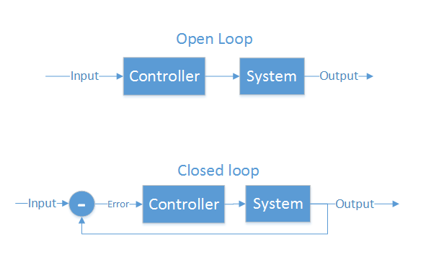
Control Theory
Making a physical system do what you want
“Open loop” and “closed loop”
Open loop - cannot see the system’s output
Motor controllers
LCD/LED/CRT screens
Closed loop - Can see output, make corrections
Autopilot
GPS guided munitions
Our quadcopter

Slide 22
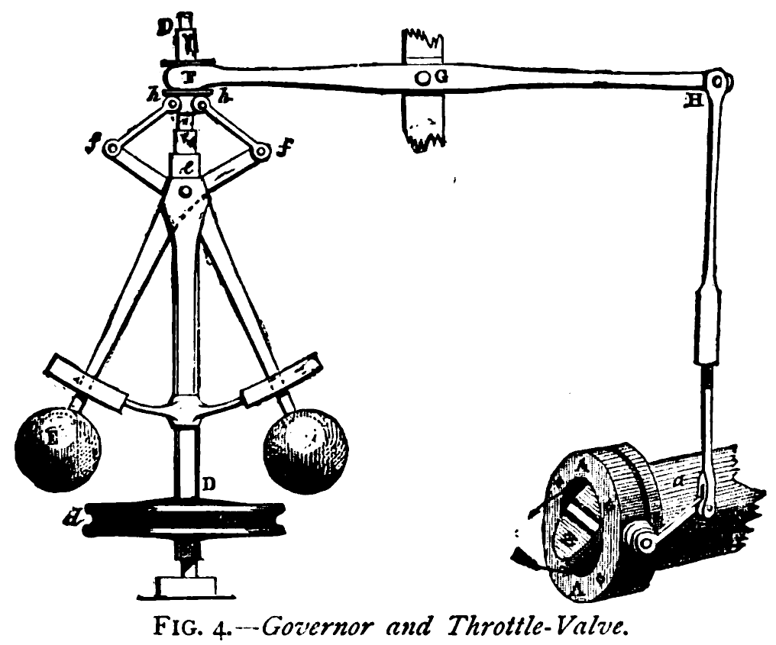
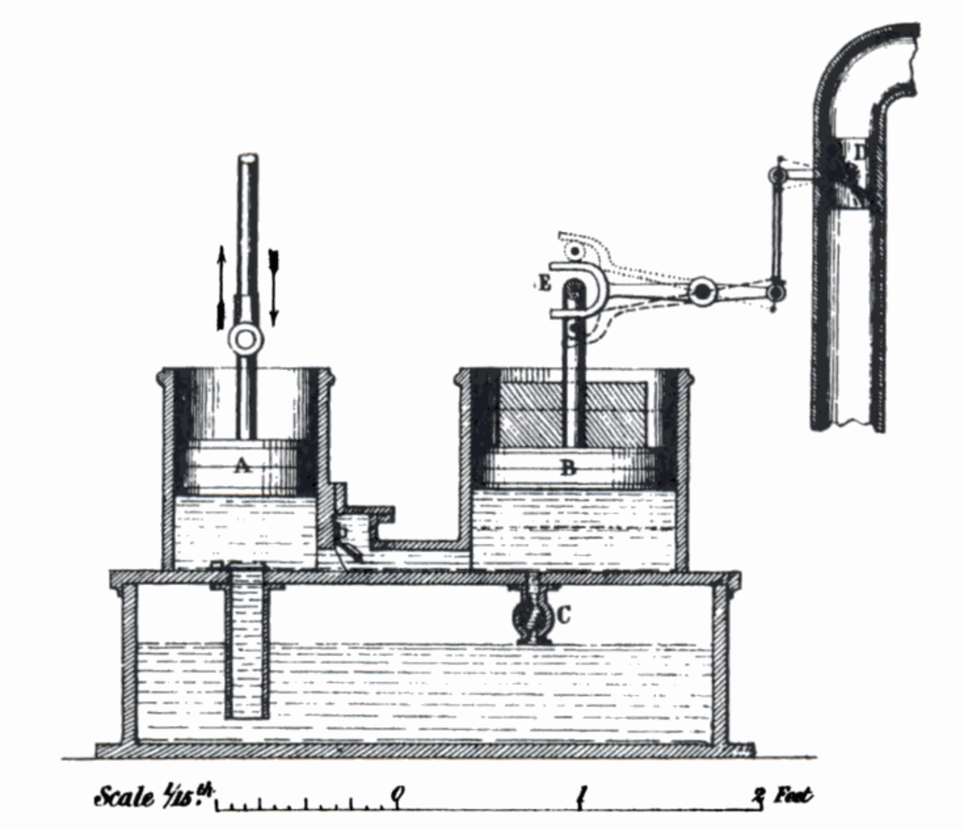
What is PID?
Make a system follow a set point
“Proportional, Integral, Derivative”
A brief history:
1788 - James Watt’s flyball governor (P)
1837 - Louis Molinié hydraulic regulator (PI)
1857 - H.N. Throop marine engine governor (PD)
1868 - Maxwell gives theoretical basis
1911 - Elmer Sperry, ship steering (PID)

Slide 23
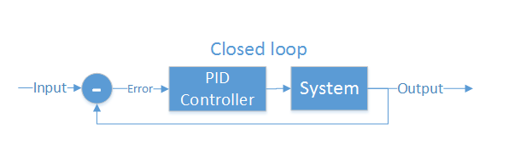
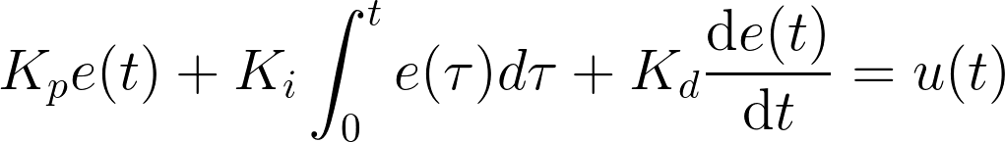
Closed loop control
PID is the most common closed loop controller
Proportional: Directly against error
Integral: Remembers error over time
Derivative: Dampens response to avoid oscillations

Slide 24
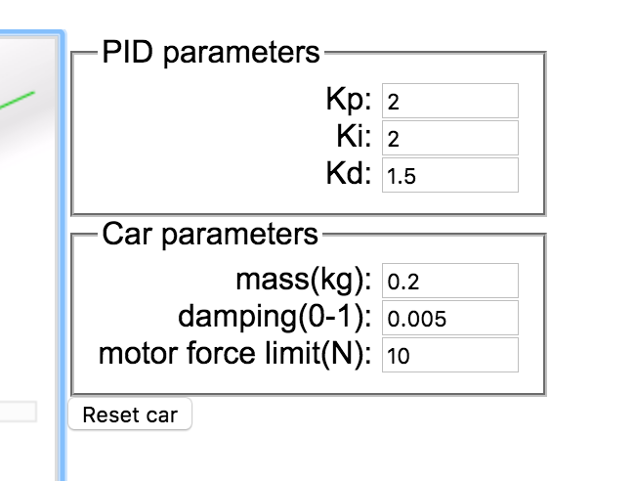
Example
https://sites.google.com/site/fpgaandco/pid

Slide 25
PID on the Quadcopter
3 separate controllers
PID set point is from user

Slide 26
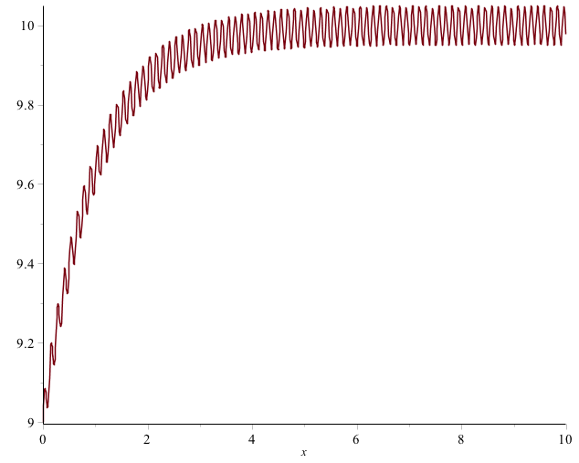
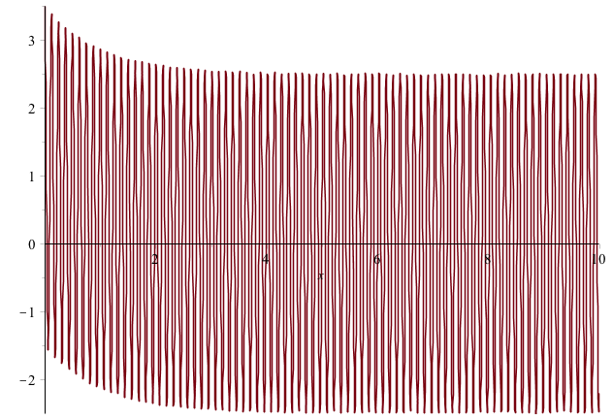

Pitfalls of PID
Integral term “Windup”
One solution: Exponential decay on integral (E.g., I = I/2 + error)
Derivative noise: beware of noise.
Solution: moving average of last several values. Or median of last several values.
Using the serial plotter in arduino to watch the D term.
3. Tweaking PID values
Tune P first, then D, then I.
Error term with vibration
Derivative term causes your system to go insane

Slide 27
Implementation
NOTES:
Where to get the derivative?
Integral windup
Pay attention to rate (hz)
Relative scale of inputs and outputs
Make sure timestep is consistent

Slide 28
How important in speed?
The key number is how many times/sec your PID loops (Hz)
The internet suggests > 100Hz (10ms/cycle) is necessary for stable flight.
My non-optimized code runs at 400Hz (2.5ms/cycles)
Action | Latency (ms)
Reading IMU | 7.360
analogWrite() | 0.012
analogRead() | 0.104
Integer PID (one channel) | 1.880 (531Hz)
FP PID (one channel) | 1.888 (529Hz)
AHRS getOrientation() | 1.860
rfWrite() 16 bytes | 0.812
Serial.write(“a”) | 0.906

Slide 29
Tuning
Tuning PID is a bit of an art form.
Simple algorithm
Set P=I=D = 0
Increase P until it starts oscillating, reduce until it oscillates just a bit
Increase D to till it stabilizes pretty quickly
Increase I to fix offset
Increase D as much as possible with causing oscillation.

Slide 30
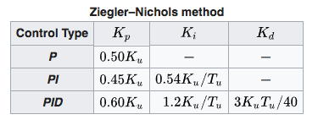
Tuning
Zeigler-Nichols method.
P=I=D= 0
Increase P until oscillations start. P is now at Ku, oscillation is at frequency Tu.
Follow the chart.
It’s important that your PID look incorporate its execution interval correctly.

